Slide 1



Capgemini
CONSULTING. TECHNOLOGY. 0 UT SOURCING
People
matter.
results
count.
Fresher Learning
Program
Teradata Training – Fast Export
Location, Date, Author

Slide 2

Introduction about Teradata Utility
What is the need of Teradata utilities in Data ware house:
➢
➢
Quick access to data for more timely decision making.
Solutions for the entire spectrum of load requirements from batch
time.
Unmatched scalability for large volume loads.
Fail-proof loads with checkpoint restart capabilities.
to
near
real
➢
➢
➢
➢
Proven technology from the data warehouse technology
Integration with industry-leading ETL and ELT tools.
leader.
Presentation Title | Date
Copyright © Capgemini 2015. All Rights Reserved 2

Slide 3
Introduction about Teradata Utility
Teradata Utilities:
➢BTEQ: Help for Report formatting, Ad hoc query tool, Database
administration, Best for small data volumes
➢Fast Export :High-performance data unload in client format.
➢Fast Load: High-performance initial table load.
➢Multi Load: High-performance maintenance operations
multiple tables in single pass.
applies
updates to
Apart
from
these teradata
having
other
utilities
like
Teradata
Parallel
Transporter, Tpump e.t.c.
Presentation Title | Date
Copyright © Capgemini 2015. All Rights Reserved 3

Slide 4
Module
Object
➢ Fast Export Definition
➢
Supporting Environment
➢
Execution Process
➢
Start with .BEGIN EXPORT
and .END EXPORT
➢
Set the output file with .EXPORT
➢Fast Export Support and Task Commands
➢ Some key features of Fast Export
Presentation Title | Date
Copyright © Capgemini 2015. All Rights Reserved 4

Slide 5
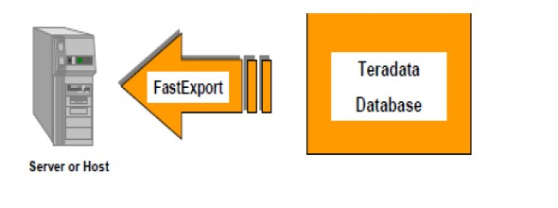
Fast Export Definition
Fast export known for its lighting speed , it comes to exporting large volumes
of
formatted data from Teradata
attached system.
to
a
host
file
on
either
mainframe
or
network
Features:-----
➢It support
➢It support
➢It support
multiple sessions.
multiple tables.
the restartibilty.
Recommendation:----
➢ Fast export
is
the best
choice
if
the
volume
of
data
more than
half
a
million
records.
Presentation Title | Date
Copyright © Capgemini 2015. All Rights Reserved 5

Slide 6
Supporting Environment
The Fast Export utility is supported either on either the mainframe
attached system(LAN)
or
on
network
The
LAN
environment supports
➢UNIX MP-RAS
➢Windows 2000
➢Windows 95
➢Windows NT
➢UNIX HP-UX
➢AIX
➢Solaris SPARC
➢Solaris Intel
the
following
Operating
Systems:
The
Mainframe (Channel Attached)
environment supports the following
Operating Systems:
➢MVS
➢VM
CAUTION: The Teradata RDBMS will only support a maximum of 15 simultaneous
FastLoad, MultiLoad, or FastExport utility jobs
Presentation Title | Date
Copyright © Capgemini 2015. All Rights Reserved 6

Slide 7
Execution Process
➢Logon to Teradata for the utility Fast Export.
➢.BEGIN EXPORT
➢Create utility logs into Teradata database.
➢Retrieves records from Teradata Database and
put
them
into
SPOOL.
➢Pass the records from SPOOL to work tables.
➢Blocks are created and distributed into AMP.
➢.END EXPORT
➢Logoff Teradata Database.
Presentation Title | Date
Copyright © Capgemini 2015. All Rights Reserved 7

Slide 8
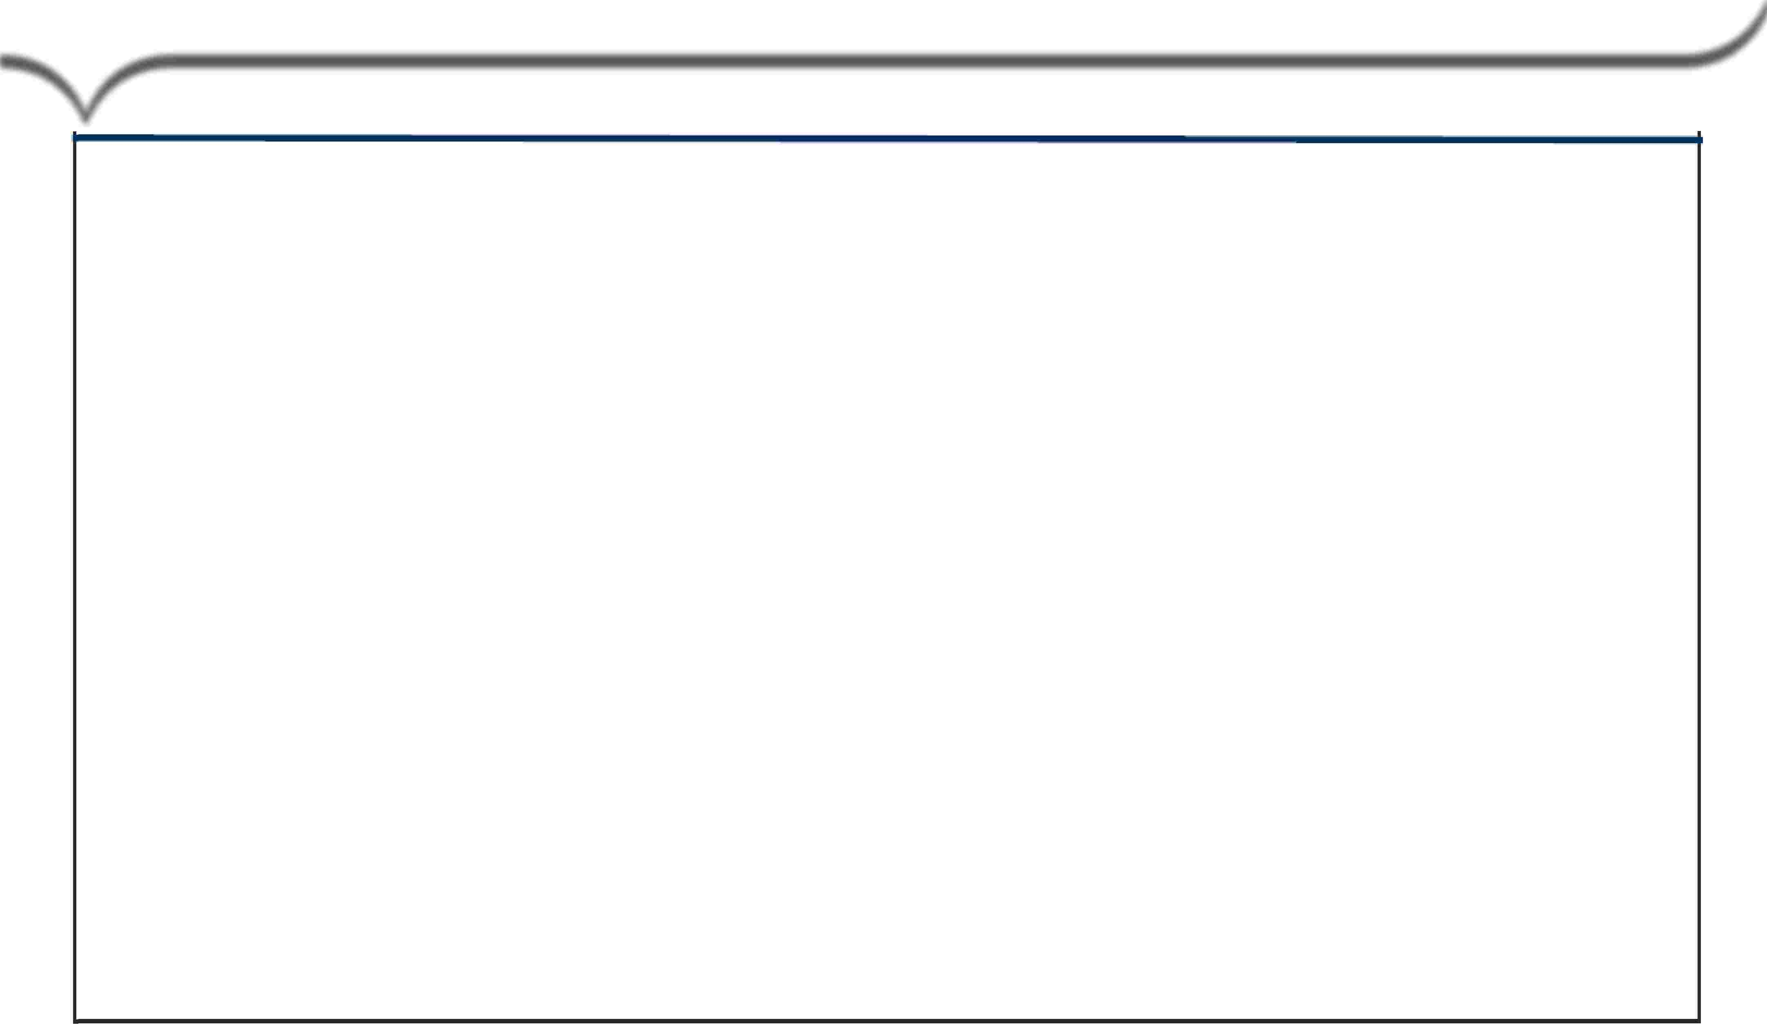





Start with .BEGIN EXPORT and .END EXPORT
.BIEGIN EXPORT
.BEGIN EXPORT TENACITY
SLEEP
SPOOLMODE
NOTIFY
rsESSIONS max [min]
hours
minutes
SPOOL I NOSPOOL NOSPOOLONLY
OFF LOW I MEDIUM HIGH ...,];
SESSIONS
•,
Maximum.. and optionally, minimum
Fast Export.
number of sessions the utility may use - defaults to 4 for UNIX
•,
The utm1ty wiH log on two additionalll SQ[Lsessions: one for the Restart· Log and one for the SEl.ECT.
TENACITY
•,
SLEEP
•,
Number of hours FastExport wi1II try to establish a connection to the system; default is 4.
Number of minutes that FastExport willl wait between lllogon attempts, default is 6.
NOTIFY
•
•
Parameter for specifying the notify user exit option
The f'astExpo1rt manualll spedfi1es i1n detai1lll whkh events are associated with each lllevelll .
I
. END EXPORT;
•,
•,
Delirnlts a series of commands that define a single EXPORT action.
Causes the utilitv to send the SIE .E1CT(s) to the Teradata Database.
Capgemmi
CON 5 ULT I NG. TECH NOL O G Y. 0 UT 5 0 UR CI NG
Presentation Title | Date
Copyright © Capgemini 2015. All Rights Reserved 8

Slide 9

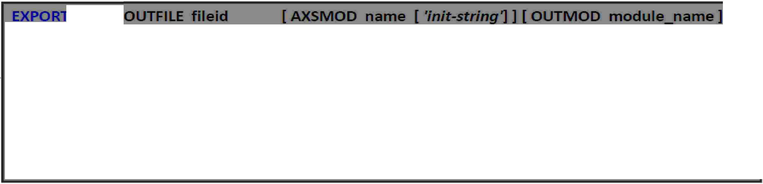

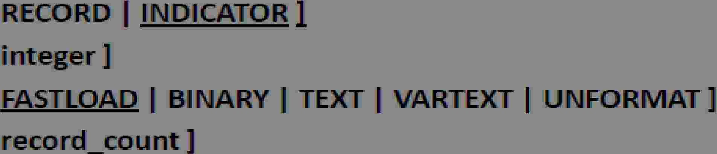










Start
with
.BEGIN
EXPORT
and
.END
EXPORT
MODE
If RECORD, then i'1ndlicat¹or lbyt¹es, fo1r r·. ULLs, a1re 1not mcluded ln exported da1ta1.,
If INDICATOR, then ind-ca1tor bytes 'for NU Ls are i'1ncl1uded ln exipo1rted data,
BLOCKSIZE
Defines, the, 1m1ax1imiu1m1 block size to be used in1 1retulining exported data., Def.au It (and
max:i'mum) i's, 63.,5 KB.,
FORMAT
Record format ¹of the export fil¹e, on netw·o1rk-attached UNIX and Windows, IP a1tforms,.
OUTLIMIT
Defines, the, 1m1axiimiu1m1 number of records to lbe Wli-tten to , he output host fi' e,
MLSCRIPT
Fast xport gene:ra1tes a 11 JUI ,_Load scrlpt that can be used ater to load the exported data back into, a Teradata syst¹e:m1.,
Capgemmi
CON 5 ULT I NG. TECH NOL O G Y. 0 UT 5 0 UR CI NG
Presentation Title | Date
Copyright © Capgemini 2015. All Rights Reserved 9

Slide 10











A
Fast
Export
Script
Define log table for Restartibilty
Connect to database
loetable U_QUAL2.tllo1,
. aeon 10.67 .180.194/U_QUAL2,U_QUAL2,
Specify the number of Sessions
.becin export sessions 4;
.export outfile fex_out.txt mode record format text;
se ect
course_·d (char(l)),
course_name (VARC
cred" (char(S)), seats (char(5))
from course_tab e 1;
Destination File
AR(20)),
SQL
.end export;
Send Request
• oeoff;
Capgemmi
CON 5 ULT I NG. TECH NOL O G Y. 0 UT 5 0 UR CI NG
Presentation Title | Date
Copyright © Capgemini 2015. All Rights Reserved 10

Slide 11
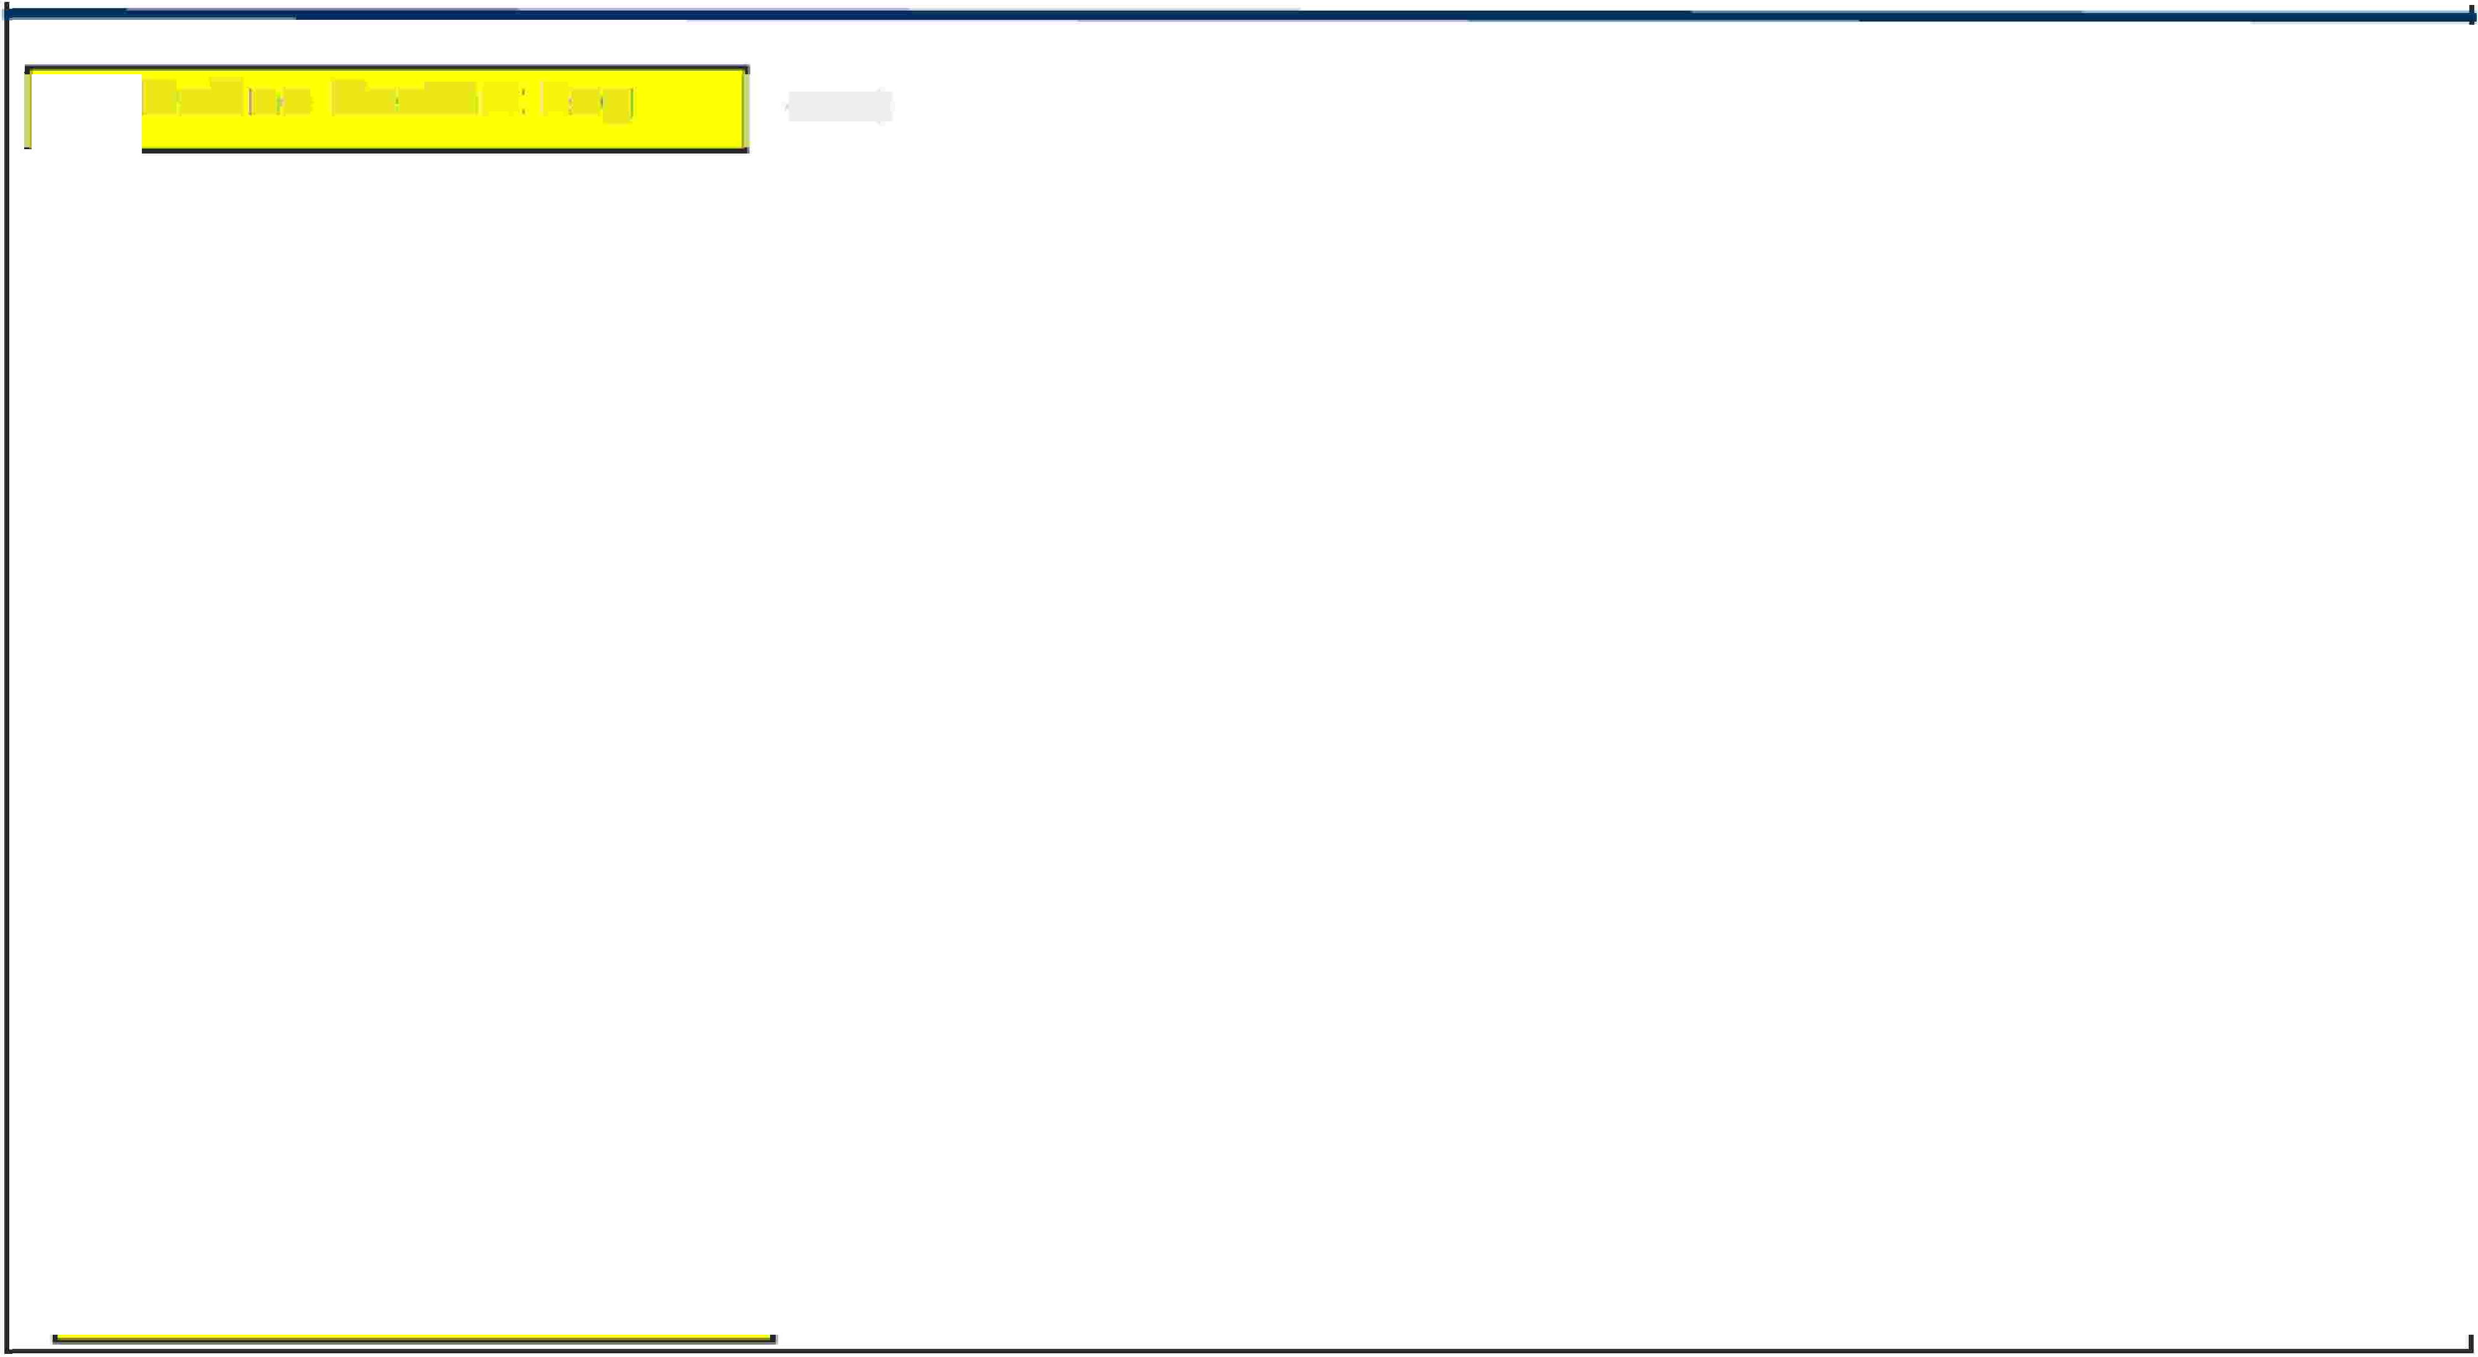












A
Fast Export Script
I
I -----t
Define Restart Log1
.LOGTAB,LE
.RU
.SET
.SET
.BE¹GIN
.EXPORT
Restartlogl_fxp;:
FIILE logon;
CityName TO 'Los Angeles,�;
Zip¹Code TO 90666,;
EXPORT SESSIONS 4;
OUTFll llE custacct_data;
I
]
;
-----t
__,,,,,,,
Spedfy number of sessions
Destination file
Via a SELECT,. speclfv the
SELECT
A.Account: INu m ber
, C.Last Name
, C.F'irst:_Name
, A... Balance_Curre t
Aecounts A
Aocounrts. Customer AC
Custo mer C
collumns and
rows to export.
FROM
INNEIRJOIN
ININlEIR JOINI
ON
ON
WHERIE
A D
ORDER BY
.END EXPORT;
C.Cus,tomer Number= A.C...Customer Number
A.Account: Number= AC..Ac¹count umber
A.¹City·
= ·&cityName··
A ..Zip_Code = ,&ZipCode
1"_{J}'
Send
request.
I
----+
I
.LOGOFF;
I
Terminate sessions
11----+--------------------------------
Capgemmi
CON 5 ULT I NG. TECH NOL O G Y. 0 UT 5 0 UR CI NG
Presentation Title | Date
Copyright © Capgemini 2015. All Rights Reserved 11

Slide 12





Multiple Export in one fast
Export
Script
.logtable U_QUAL2.t11og;
.logon 10 67.180.194/U_QUAU,U_QUAU•
• DISPLAY 'Exporting fex_out1.txt-&SYSOATE4 TO F LE D:\Sandeep\a.txt•
• export outfile fex_out1.txt mode record format text;
select
course_id (char{t)),
course_name (VAROIAR(20)), aedit (char{3)),.
seats (char(S))
from course_table1;
.DISPLAY 'Exporting fex_out2.txt-&SYSOATE4 TO F LE D:\Sandeep\a.txt•
• export outfile fex_out2.txt mode record format text;
select
course_id (char{t)),
course_name (VAROIAR(20)), aedit (char{3)),.
seats (char(S))
from course_table2;
.logoff
Capgemmi
CON 5 ULT I NG. TECH NOL O G Y. 0 UT 5 0 UR CI NG
Presentation Title | Date
Copyright © Capgemini 2015. All Rights Reserved 12

Slide 13
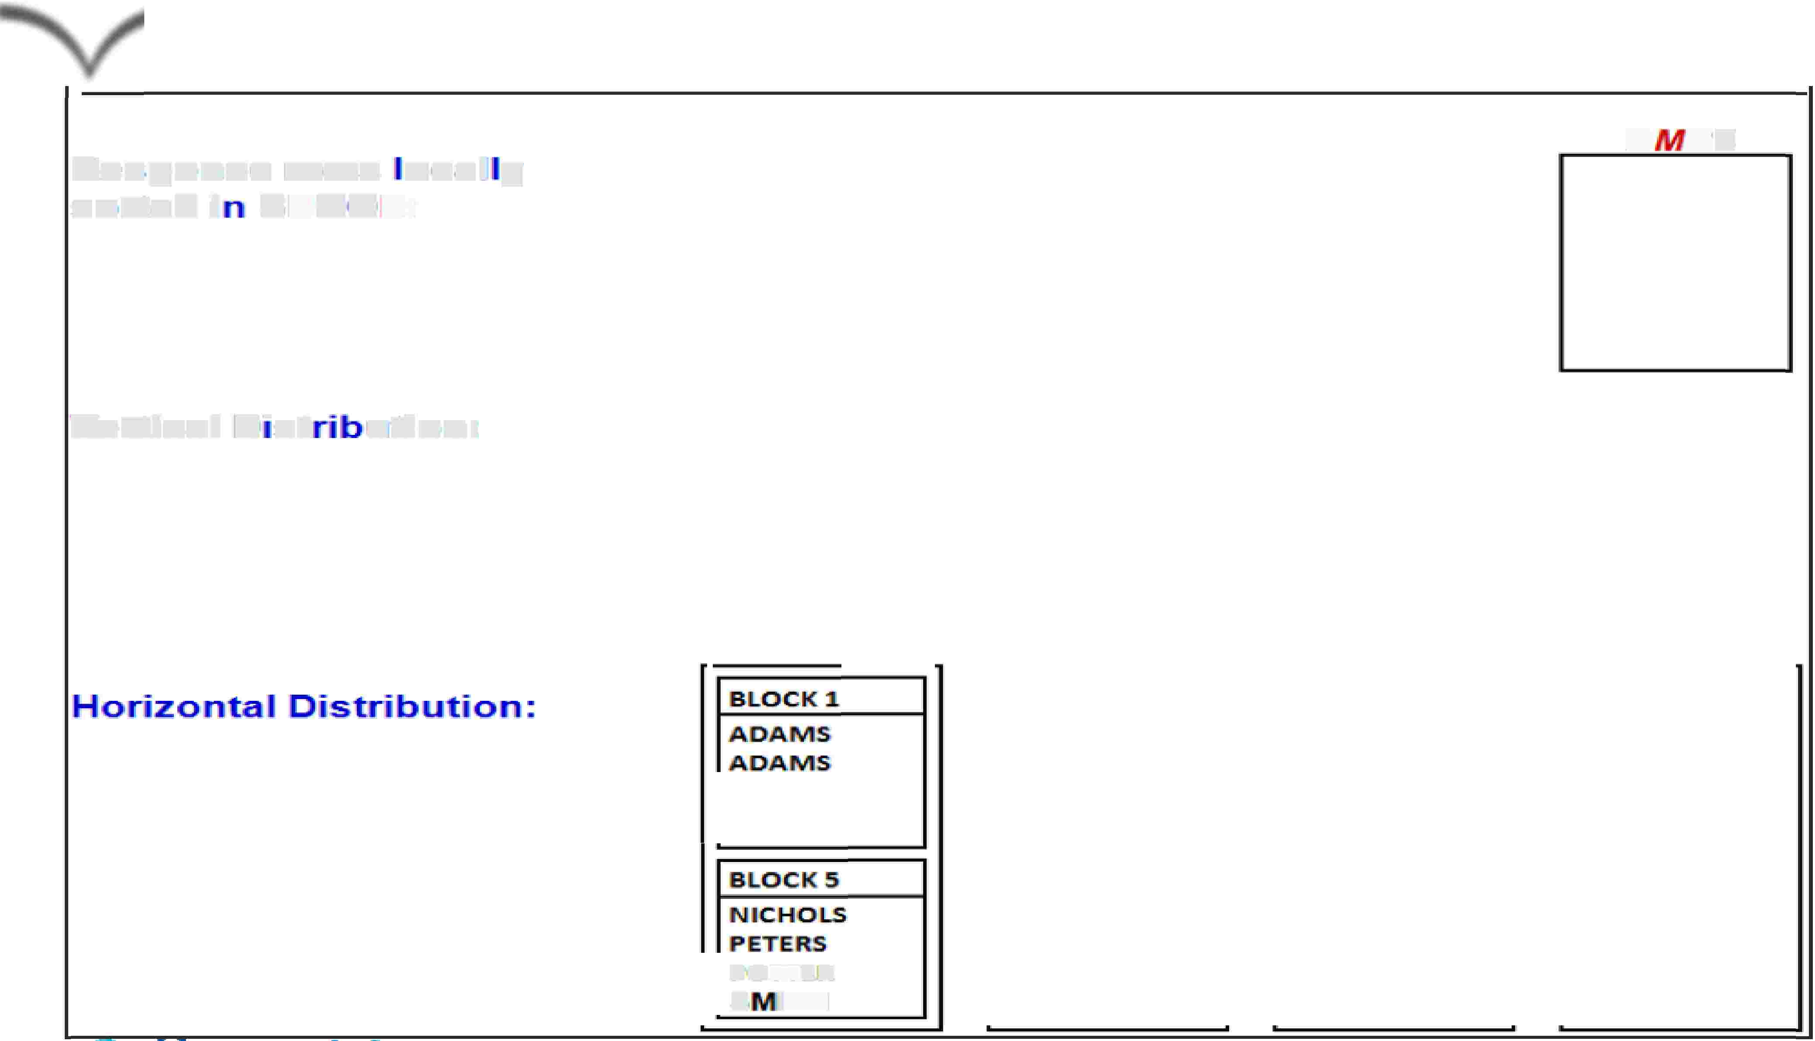
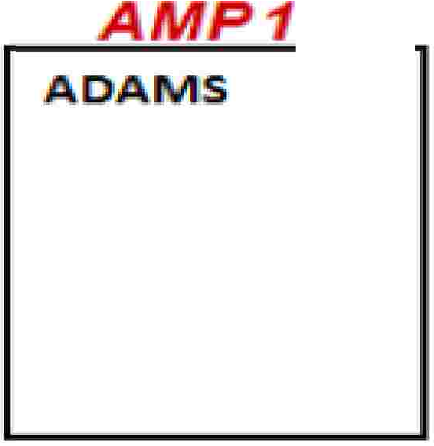



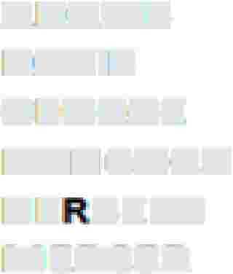













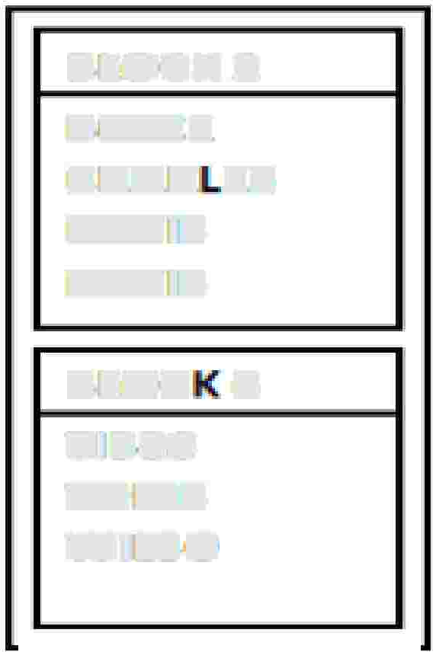
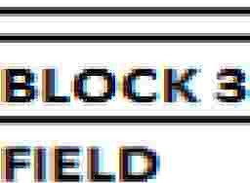





The SORT
Procedure
Re·spons.¹e 11"0¹ws _ocal_y
son,ed i-- S1P00¹L:
A
P.2'
A
B¹0YCE
CHARLES
' ERBE ·T
P¹0TTE.R
A
P'4
BATES
DAVIS
Kl El
- ICHOLS
PETERS
TilBBS
TOMS
ADAIMS
B,OYCE
1
DAVIS
GEORGE
HANl1COCK
HE-B,ERT
MERiC!ER
FIE
_{D}1
JONES.
SMIT
WIIILS.ON
Venical
ID¹"'st
- utton:
ADAMiS
ADAMS
DAVIS
DA:Vlrs
HEAB:rE:R:T
HE BE :T
ICHOLS
TIJB,BS
BATES
BOYCE
BOYCE
GIE.OR·GE
CHARLJES
FIELD
HA.r COCK:
J01 ES
PETERS
TOMS
I EIL
Ml
CER
SMITH
BLOC.K 2
a,ovce
1CHAR ES
DAVIS
DAVIS
B,ILJOiCK 4
HER.B¹ERT
JONES,
KIEL
MIERCER
B, -TES
BOYCE
GEOREi'E
HA ·coc
-ERBERT
BLOC 6
TilBBS
TOMS
WILSO
POTTER.
S
ITH
Capgemmi
CON 5 ULT I NG. TECH NOL O G Y. 0 UT 5 0 UR CI NG
Presentation Title | Date
Copyright © Capgemini 2015. All Rights Reserved 13

Slide 14




Important Commands and meaning
Task Commands
BEGIN EXPORT
Begins the export task and sets the specifications for the number of sessions with
Teradata.
Ends the export task and initiates processing by Teradata.
Provides. two things. which are.. The client destination and file format specifications
for the export data retrieved from Teradata, A. generated Multi Load script file that
can be used later to reload the export data back into Teradata
Constitutes a field in the input record section that provides data values for the
END EXPORT
EXPORT
FIE D
SE LE CT state me
t.
FIILLER
Specifies a field in the input record that uvill not be sent to Teradata for processing.
It is part of the input record to provide data values for the SELECT statement.
IMPORT
Defines the file that provides the USING data values for the SELECT.
LAYOUT
Specifies the data layout for a file. It oonta ins a sequence o
FIELD and FILLER
commands. This is used to describe the import file that can optionally provide data
values for the SELECT.
Capgemmi
CON 5 ULT I NG. TECH NOL O G Y. 0 UT 5 0 UR CI NG
Presentation Title | Date
Copyright © Capgemini 2015. All Rights Reserved 14

Slide 15
Key features of Fast Export
➢Fast Export EXPORTS data from Teradata.
Fast Export does not import data into Teradata , like BTEQ it can output
multiple files in a single run.
➢ Fast Export only supports the SELECT statement.
The only DML statement that Fast Export understands is SELECT.
➢ Choose Fast Export over BTEQ when Exporting Data of more than half a million+
It is recommended use Fast export , if you have huge volume of data for exporting.
rows.
➢ Fast Export supports multiple SELECT statements and multiple tables in a single run.
Fast Export supports multiple select and each select can use 64 tables.
➢ Fast Export supports conditional logic, conditional expressions, arithmetic calculations,
data conversions.
and
➢ Fast Export does NOT support error files or error limits.
Presentation Title | Date
Copyright © Capgemini 2015. All Rights Reserved
15

Slide 16







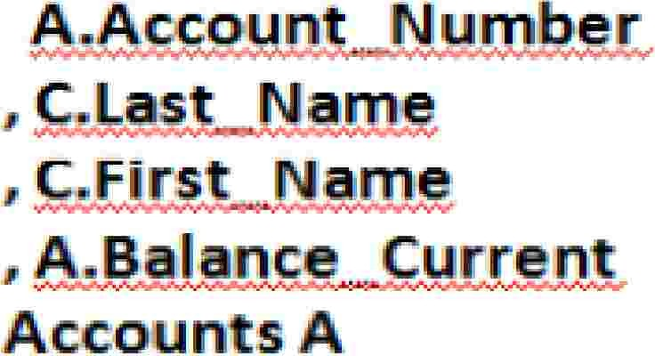



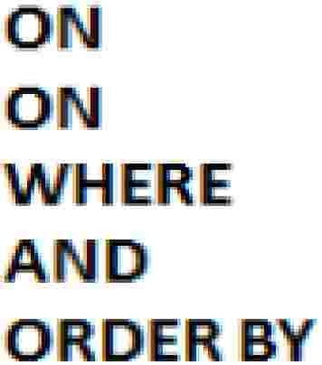
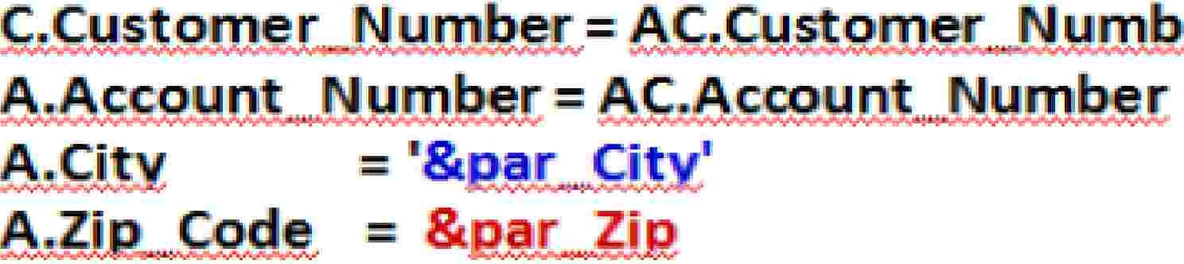






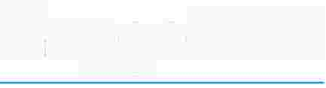
A FastExport Script
with
ACCEPT
'Los Angeles' 90066
.L.OGTAB
.RU .
E
[par_City par_Zip
ACCEPT variables from input
record.
)
.ACCEPT
IL
. parmrr
e
;
.BEGI
EXIPOR.T SESS D' 54.;
.EXPO;
SELECT
FRO.
I
I
I.
·.
ER JOI I
E · JIOINI
.Acoo nts 1Custo
Custo,merC
c.c s- .·
eri· AC
er
Reference accepted
variables with an&.
.1;
.END EXPORT.;
Capgemmi
CON 5 ULT I NG. TECH NOL O G Y. 0 UT 5 0 UR CI NG
Presentation Title | Date
Copyright © Capgemini 2015. All Rights Reserved 16

Slide 17
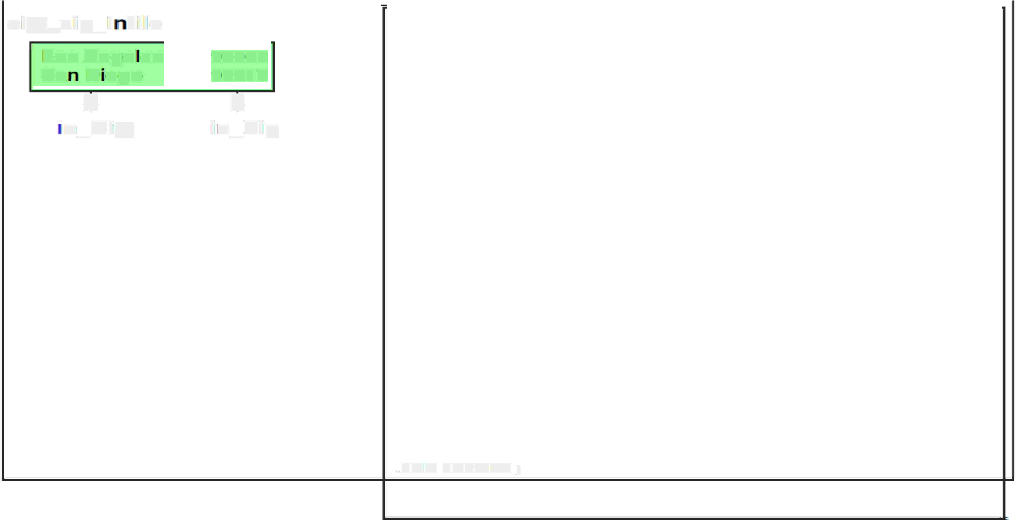



















A
FastExport Script with LAYOUT
ciity�zip_ii fiil,e·
Los Ange es
,.LOGTABlE
Res.t:a rt Log1 _fx p;
90066
90217
J,
in._Zip
,.RUN
,.. BEGIIN
IFILE logon ;:
EXPORT SESSIIDNS 4;
Sa
D
J.-
ego
.. LAYOUT
..HELD
..HELD
Record_Layout ;
in_City·
in_Zip
· n._City
1 CHAR(2D);
* CHAR(S);
IIMPORT fields input records.
from
)
.. IMPORT
I NFILE city_zi p_'infile LAYOUT Re,cord_Layout ;
.. EXPORT
SELECT
OUTFIILIE cust_,acct,_outfile2;
A.. Account_Number
,. rC.ILast_Name
, rC.IFir.st_Name
, A .. Bal,a n c,e_Current:
Accounts A
Acoount's_Customer AC
CustomerC
FROM
INNER .JOIN
INNER .JOIN
ON
ON
'WHIERE
A.ND
OIRDER BY
C..Customer _Number= A¹C .. iOustnmer_Number
A.Acco,unt_Number = AC .. Account_Number
Reference imported
fields wi'lh a :
)
A.City
A.Zip_Code
^{1"}I'
= :in_City
= :in_Zip
,.END EXPORT;
.. LOGDFF;
Capgemmi
CON 5 ULT I NG. TECH NOL O G Y. 0 UT 5 0 UR CI NG
Presentation Title | Date
Copyright © Capgemini 2015. All Rights Reserved 17

Slide 18

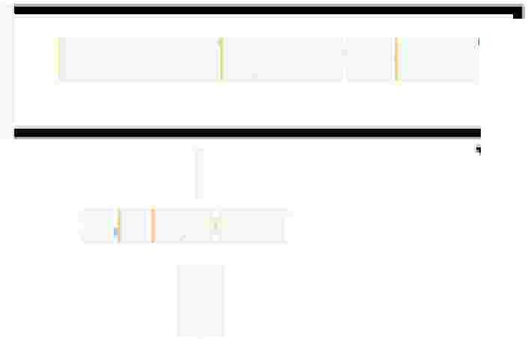




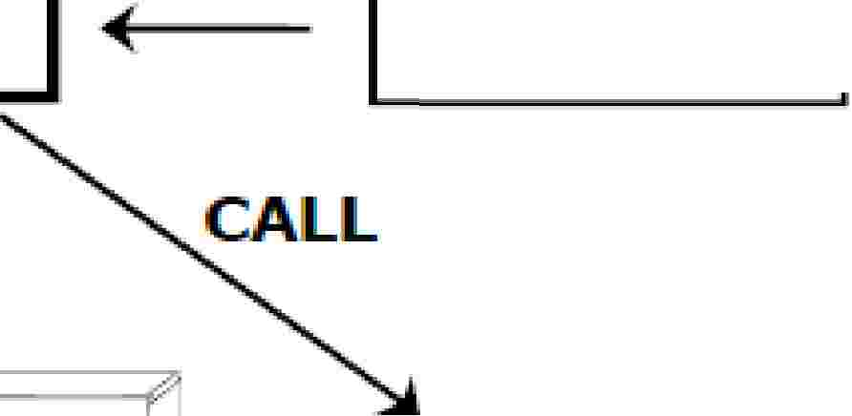







INMODs
and OUTMODs
I
CALL
READ
FASTEXPORT
I
SELECT
i
INIMOD
INPUT
DA A
/
,-7
o:
h'
I
'WRITE
�
II OUTMOD
OUTPUT'
DATA
I
[)
--
INMODs
•
•
•
Read input data
values from a file.
Qua I i1fy SELECT requests.
Usually more app icable to an import utility such as Mult:iload.
OU TM ODs
•
•
•
Process. an swer-s¹et: data.
Modify, di.sea rd, or re cord responses...
Usually more app icable to an export utllltv such as FastExport.
Capgemmi
CON 5 ULT I NG. TECH NOL O G Y. 0 UT 5 0 UR CI NG
Presentation Title | Date
Copyright © Capgemini 2015. All Rights Reserved 18

Slide 19
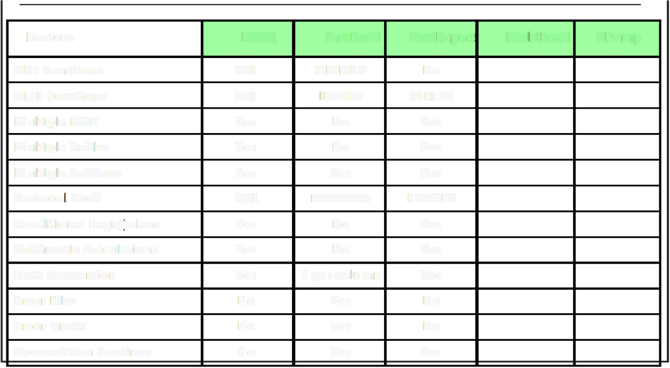
Application Utility
Checklist
Feature
BTEQ
Fastl.oad
Fastfixport
Mulltil.o,ad
TP'Ulmp
IDOL Functions
ALL
LIIMITED
INo
DML Functions
ALL
I INSERT
SELECT
IMultip,le DML
Yes.
Yes.
Yes.
SQIL
INo
Yes
Yes
Yes
EXPORT
IMultip,le Tables
INo
IMu ltiple Sessions
Yes
IfAST LOAD
Proto co Used
Cond ltlonal Exp ress ions
Yes.
Yes.
Yes.
INo
INo
Yes
Yes
Yes
INo
Arithmetic Ca I cu I at ions
INo
Data Conversion
1 per column
Error
[files
Yes
Yes
Yes
Error ILi mits
INo
INo
User-written
Routines
No
Yes
Capgemmi
CON 5 ULT I NG. TECH NOL O G Y. 0 UT 5 0 UR CI NG
Presentation Title | Date
Copyright © Capgemini 2015. All Rights Reserved 19

Slide 20
QUIZ
▪
1.Which two statements are true about data integration utilities?
(Choose two.)
A. BTEQ is limited to using one session.
B. FastExport is used to export large amounts of data.
C. BTEQ allows import/export across all supported platforms.
D. SQL Assistant supports report writing and formatting features.
Option B,C
▪
▪
▪
▪
▪
▪
▪
▪
2. what is destination file
A).export
B).logtable c)on
outfile custacct_data
restartLog1_fxp
A.Account_number=AC.customer
Option A
Presentation Title | Date
Copyright © Capgemini 2015. All Rights Reserved 20

Slide 21
QUIZ
▪
▪
▪
▪
▪
3.which utility uses select feature
A)FastExport
B)Fastload
C)Bteq
D)Tpump
Option A
Presentation Title | Date
Copyright © Capgemini 2015. All Rights Reserved 21

Slide 22
Summary
➢Best choice for exporting large amounts of
to a host file usingmultiple sessions.
data
from the Teradata database
➢ Fully automatic restart capability.
➢Specialized processing of output data
routine.
can be handled using an OUTMOD
➢Teradata accommodates not more than 15 ‘LOAD’ applications at any one
time (FastLoad,MultiLoad, FastExport).
Presentation Title | Date
Copyright © Capgemini 2015. All Rights Reserved 22

Slide 23
Q
&
A
Presentation Title | Date
Copyright © Capgemini 2015. All Rights Reserved 23

Slide 24
Lab Exercises
Lab Exercise 5-1
Purpose
In this lab, you will use FastExport to create an export file that contains one record for each transaction. You will have to join columns from two different tables in order to create the export file.
What you need
Populated TD_BIM_FR_TRNG_DB.Accounts and TD_BIM_FR_TRNG_DB.Trans tables.
Tasks
1. Create a FastExport script that outputs to file data5_1. For each transaction in the
AU.Trans
table, include the transaction_number, account_number, number, street, city, state and zip of the
associated account (AU.Accounts).
2. Run the script.
3. Test the result by opening the data file..
Presentation Title | Date
Copyright © Capgemini 2015. All Rights Reserved 24

Slide 25
Contact
information
Insert contact picture
Name
Last Name Title/Role name.lastname@capgemini.com
Insert contact picture
Name
Last Name Title/Role name.lastname@capgemini.com
Capgemini Office (Optional)
Address Line 1
Address Line 2
Address Line 3
Capgemini Office (Optional)
Address Line 1
Address Line 2
Address Line 3
Insert contact picture
Name
Last Name Title/Role name.lastname@capgemini.com
Insert contact picture
Name
Last Name Title/Role name.lastname@capgemini.com
Capgemini Office (Optional)
Address Line 1
Address Line 2
Address Line 3
Capgemini Office (Optional)
Address Line 1
Address Line 2
Address Line 3
Presentation Title | Date
Copyright © Capgemini 2015. All Rights Reserved 25

Slide 26




About Capgemini
With almost 145,000 people in over 40 countries, Capgemini is one of the world's foremost providers of consulting, technology and outsourcing services. The Group reported 2014 global revenues of EUR 10.573 billion.
Together with its clients, Capgemini creates and delivers business and technology solutions that fit their needs and drive the results they want. A deeply multicultural organization, Capgemini has developed its own way of working, the Collaborative Business Ex perienc e™ , and draws on Rightshore®,
its worldwide delivery model.
Learn more about us at www.capgemini.com.
www.capgemini.com
The information contained in this presentation is proprietary.
Copyright © 2015 Capgemini. All rights reserved. Rightshore® is a trademark belonging to Capgemini.

